Slide 1
Hackathon. November 25, 2021
Sewer hydraulics and suds
(SHY-SUDS)
Prabhat Joshi (prabhat.joshi@eawag.ch)
Eawag

Slide 2
Introduction
How does SUDS affect sewer hydraulics?

Slide 3
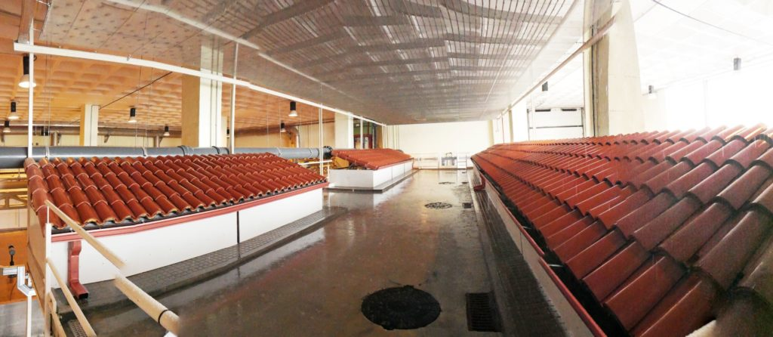
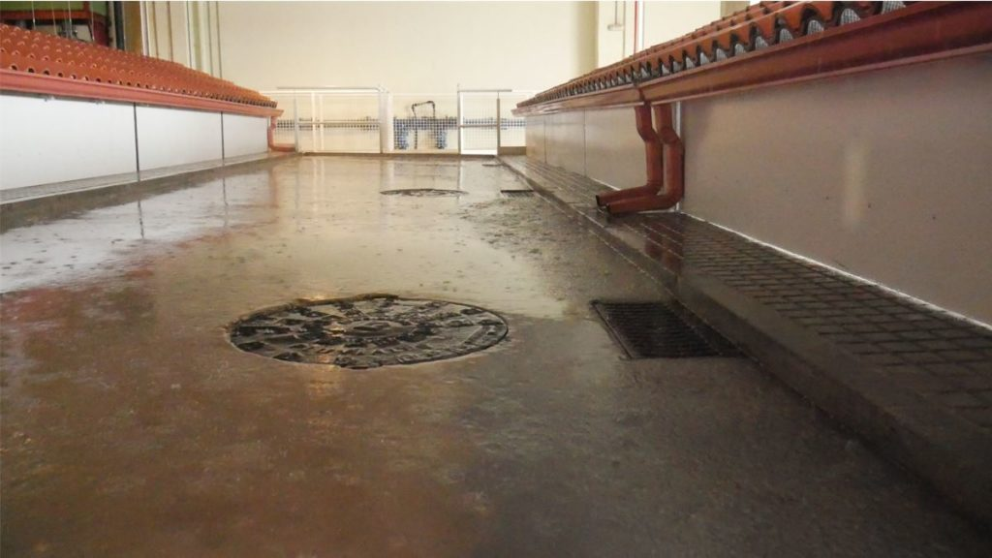
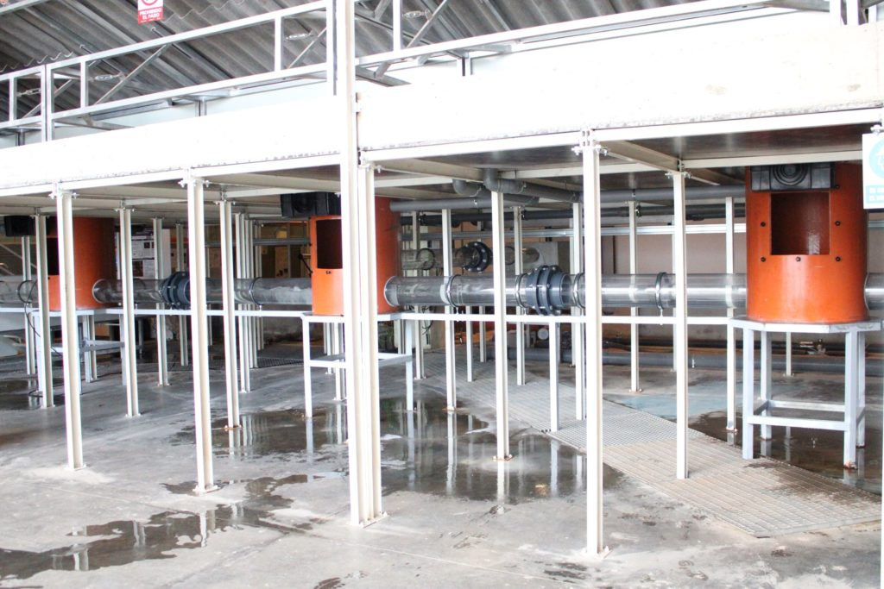
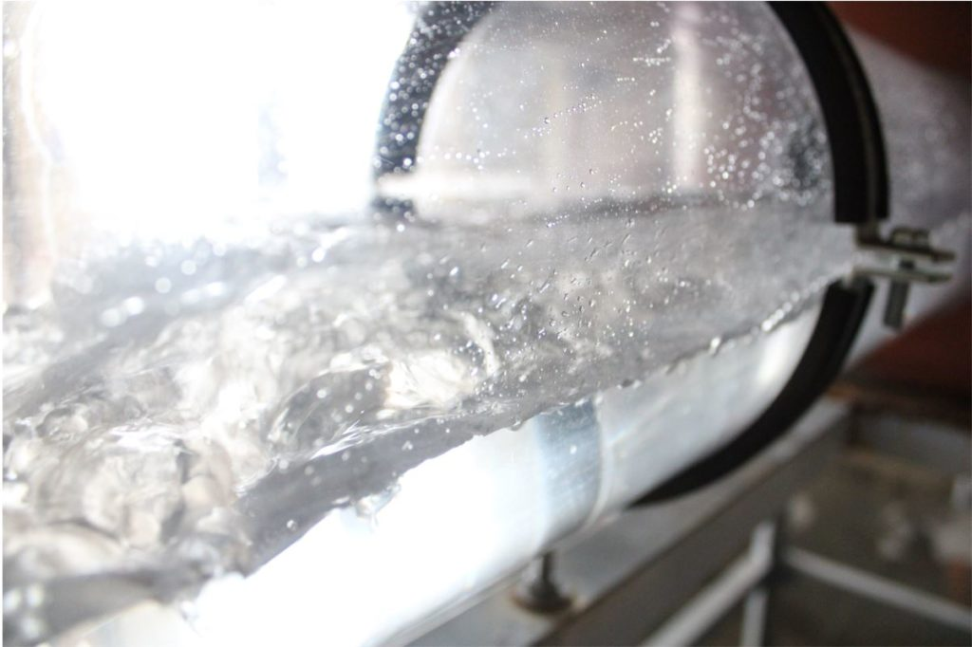
Methodology
Q_{w}/v_{w}
t
All images from: https://co-udlabs.eu/access/research-facilities/block/
d_{s}
Q_{w}/v_{w}

Slide 4
Expected results
Better understanding of how SUDS affect sewer hydraulics
SUDS operation and maintenance recommendations
Design guidelines of SUDS

