Slide 1
Hackathon. November 25, 2021
A Probabilistic ML-based Framework to Improve UDM Reliability
Proburb
Bakhshipour, A. E., Sedki, K.
Institute for Urban Water Management - Technische Universität Kaiserslautern

Slide 2
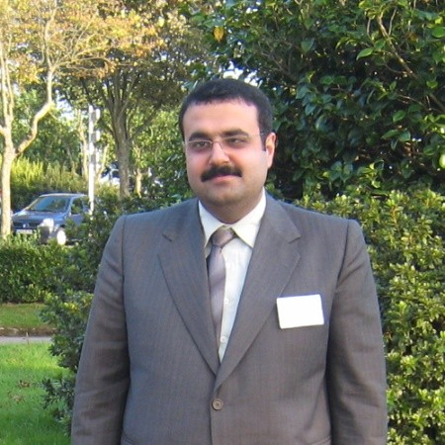
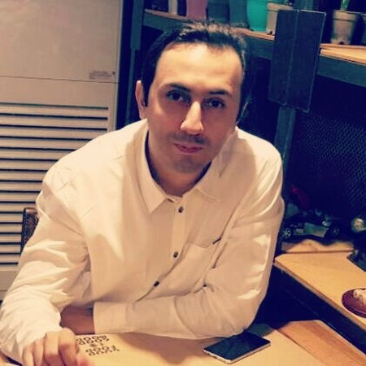
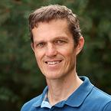
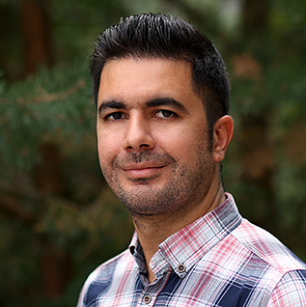
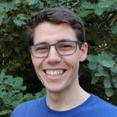
Team and idea
Abbas Haghshenas
Ali Haghighi
Ulrich Dittmer
Amin Bakhshipour
Karim Sedki
Ass. Professor
University of Tehran
Tehran, Iran
Weather Forecasting
Professor
Chamran University
Ahvaz, Iran
Hydroinformatics
Professor
TUK
Kaiserslautern, DE
Urban Drainage
Post-Doc
TUK
Kaiserslautern, DE
Hydroinformatics
PhD Candidate
TUK
Kaiserslautern, DE
Data Analysis
Notes:
1- Collecting high quality data for calibration tasks are expensive, besides Data Pre-processing is often not made in practice, manual pre-proc is a challenging and time consuming task
2- Reliability of urban drainage models and consequently optimal decision making is influenced by quality of input data
3- ML can make these tasks automatic, more reliable through standardization, and help to reduce the required data for calibration and building data driven models
4- However due to the huge sources of uncertainties common point prediction ML methods are not that promising in the field, therefore our main idea is to use probabilistic ML methods to fill the mentioned research gaps

Slide 3
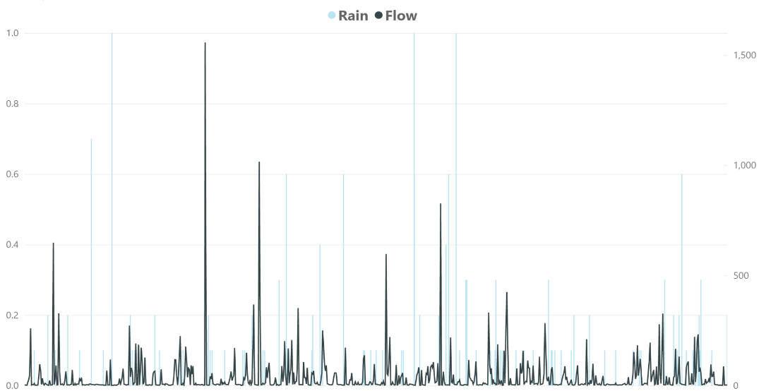
Methodology
Application with data from UWO – Digital Lab (eawag)
Exploratory Data Analysis
Model construction
Downstream tasks
Using ML methods like generative models for synthetic data generation, probabilistic anomaly detection, and missing data imputation
Developing and testing a web based application for real-time monitoring using our timeseries database (Influx-DB) for robust preprocessing, reliable alarming and data visualization
Using ML, processed and synthetic data for rainfall-runoff models with a focus on extreme events
Developing a framework to reduce amount of required data for modelling tasks without reducing model reliability
Using our weather prediction application for CSO forecasting and alarming
Controling registration interval using MPC instead of threshold depths (parameter-independent)
CSO optimization using MPC (by retaining water in the sewers)
Pre-processing
Processing
Post-processing
Notes:
1- EDA – Exploratory Data Analysis for Pre-processing the data using ML-methods
2- Processing the data within rainfall-runoff-modelling, including model construction and validation and also calibration for hydraulic models
3- Focus on data-driven models for extreme events to drop calibration needs → reduce amount of needed data by imporving input datas reliability (lower costs and time for temporal measurements e. g. of in-sewer-runoff)
4- second step of modelling will the introduction of weather predictions to forecast system responses, e. g. CSO, and to test alarming

Slide 4
Expected results
Pre-processing tools with ML-background in web-based application
Impacts from ML-pre-processed data to resulting simulation qualities
More reliable input data
Reduce needed amount of measurements
Improving model reliability
Application for MPC (model predictive control) with spatially and temporally high-res weather predictions

Slide 5
Hackathon. November 25, 2021
Tanks for your attention!
Bakhshipour, A. E., Sedki, K.
Institute for Urban Water Management
Technische Universität Kaiserslautern

